Slide 1
JOURNEY PPT
Custom IDA
19 Sept 2023 – 22 Sept 2023
- Abhishek B M

Slide 2
Week 5: Day -1 – Python cont..
Working on lists, tuples, dictionaries
Working on map, zip, lambda functions
Creating simple functions
Python user-defined functions
Different types of functions
Iterations using enumerate, for loop, range functions
String formatting in python

Slide 3
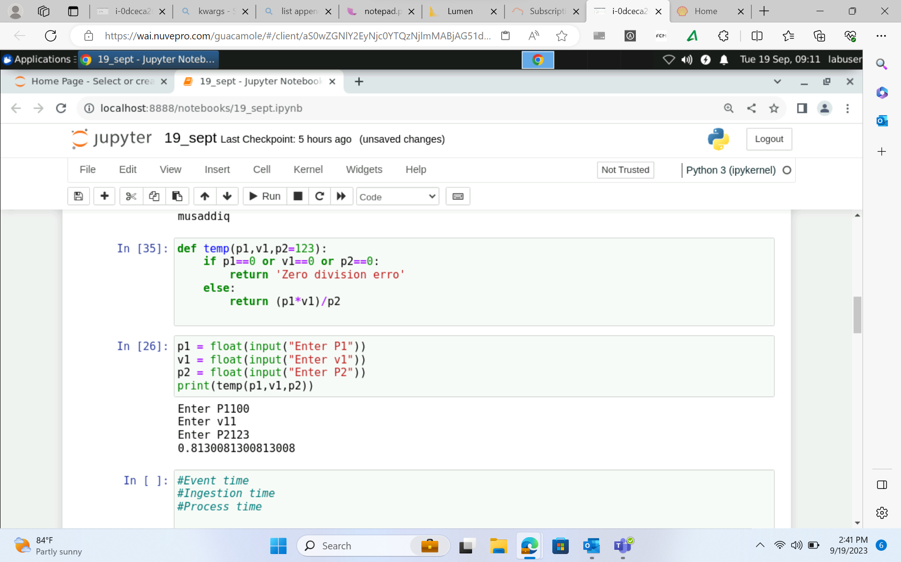
Python

Slide 4
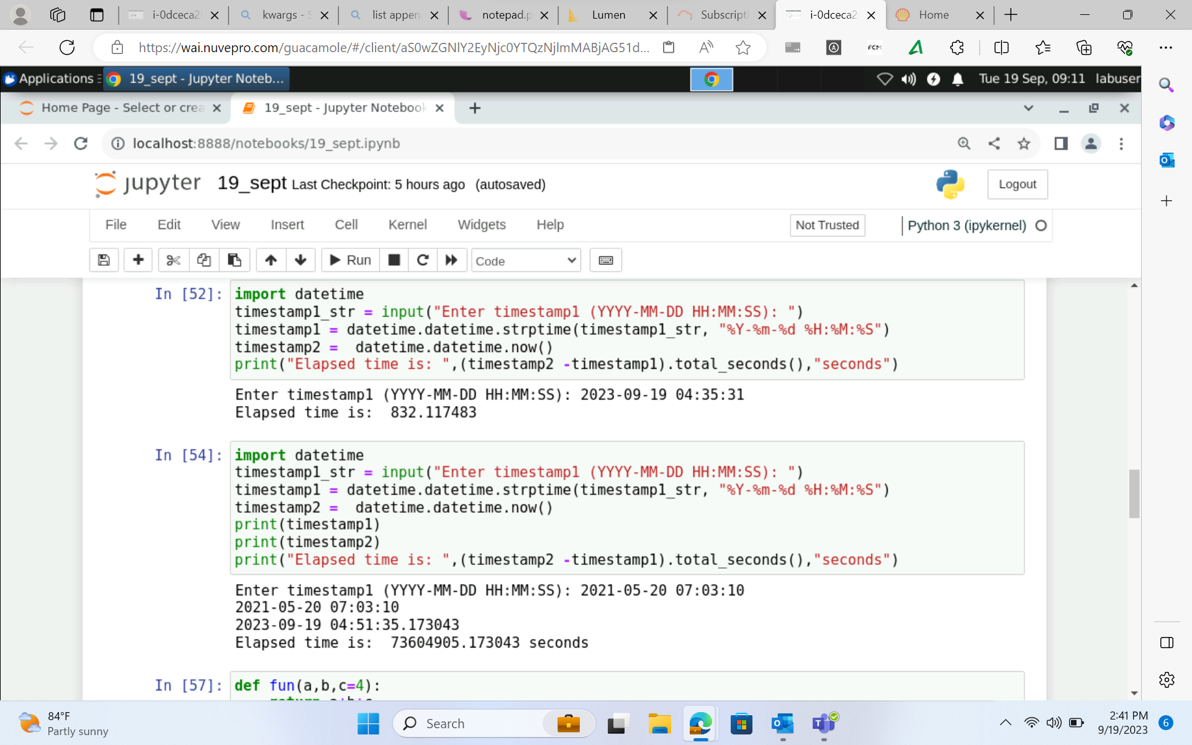
Python

Slide 5
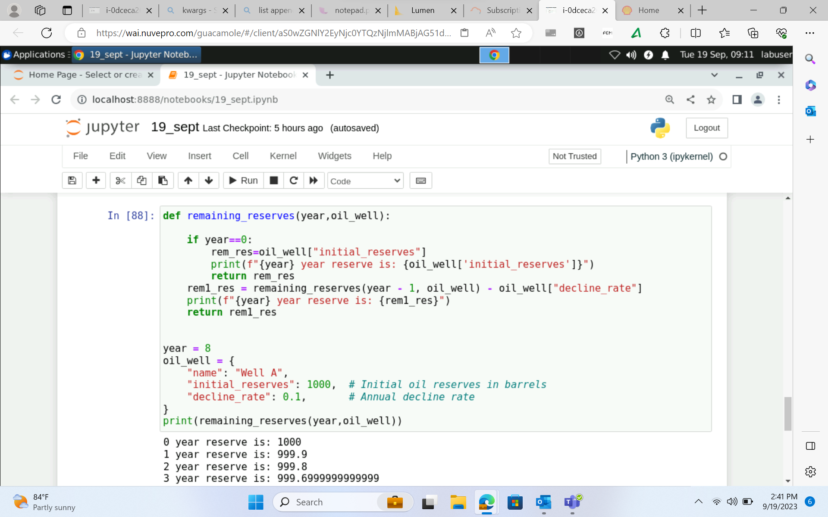
Python

Slide 6
Day – 2 Python cont..
Working more on functions
Understanding positional and keyword arguments
Introduction to pandas Data Framework
Working on series, Lists, NumPy Array
Accessing the datasets using pandas
Exploring matplotlib, Scipy, Scikit-learn
Visualizing datasets using matplotlib.py library

Slide 7
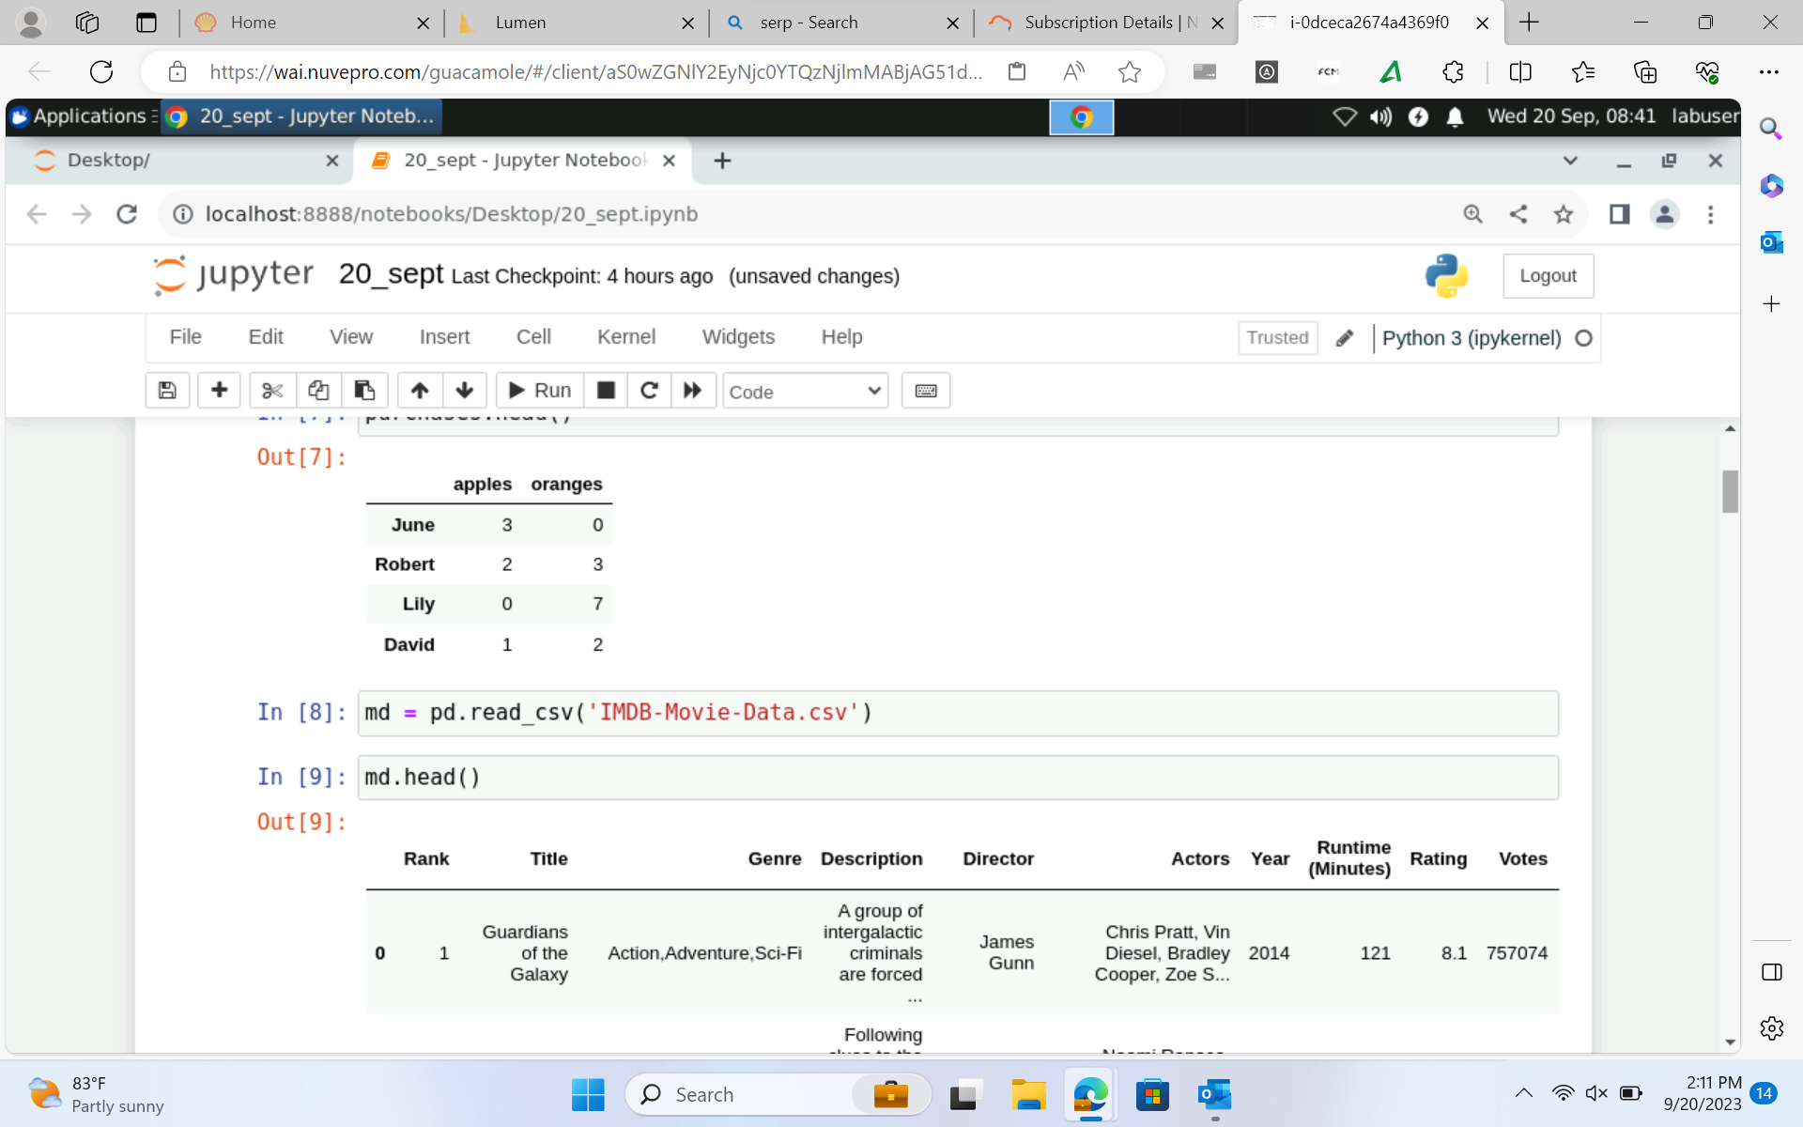
Python

Slide 8
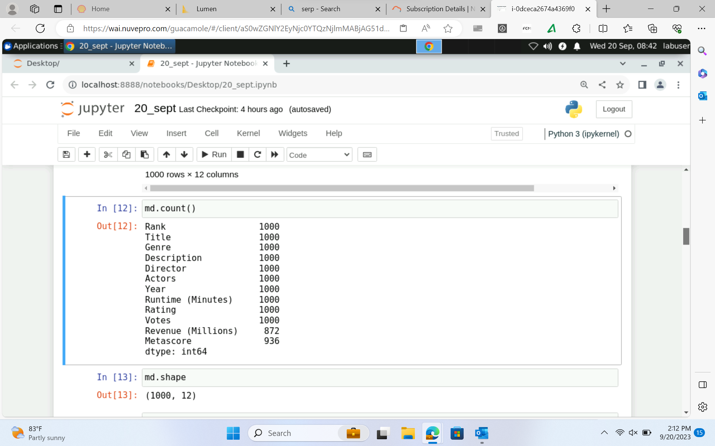
Python

Slide 9
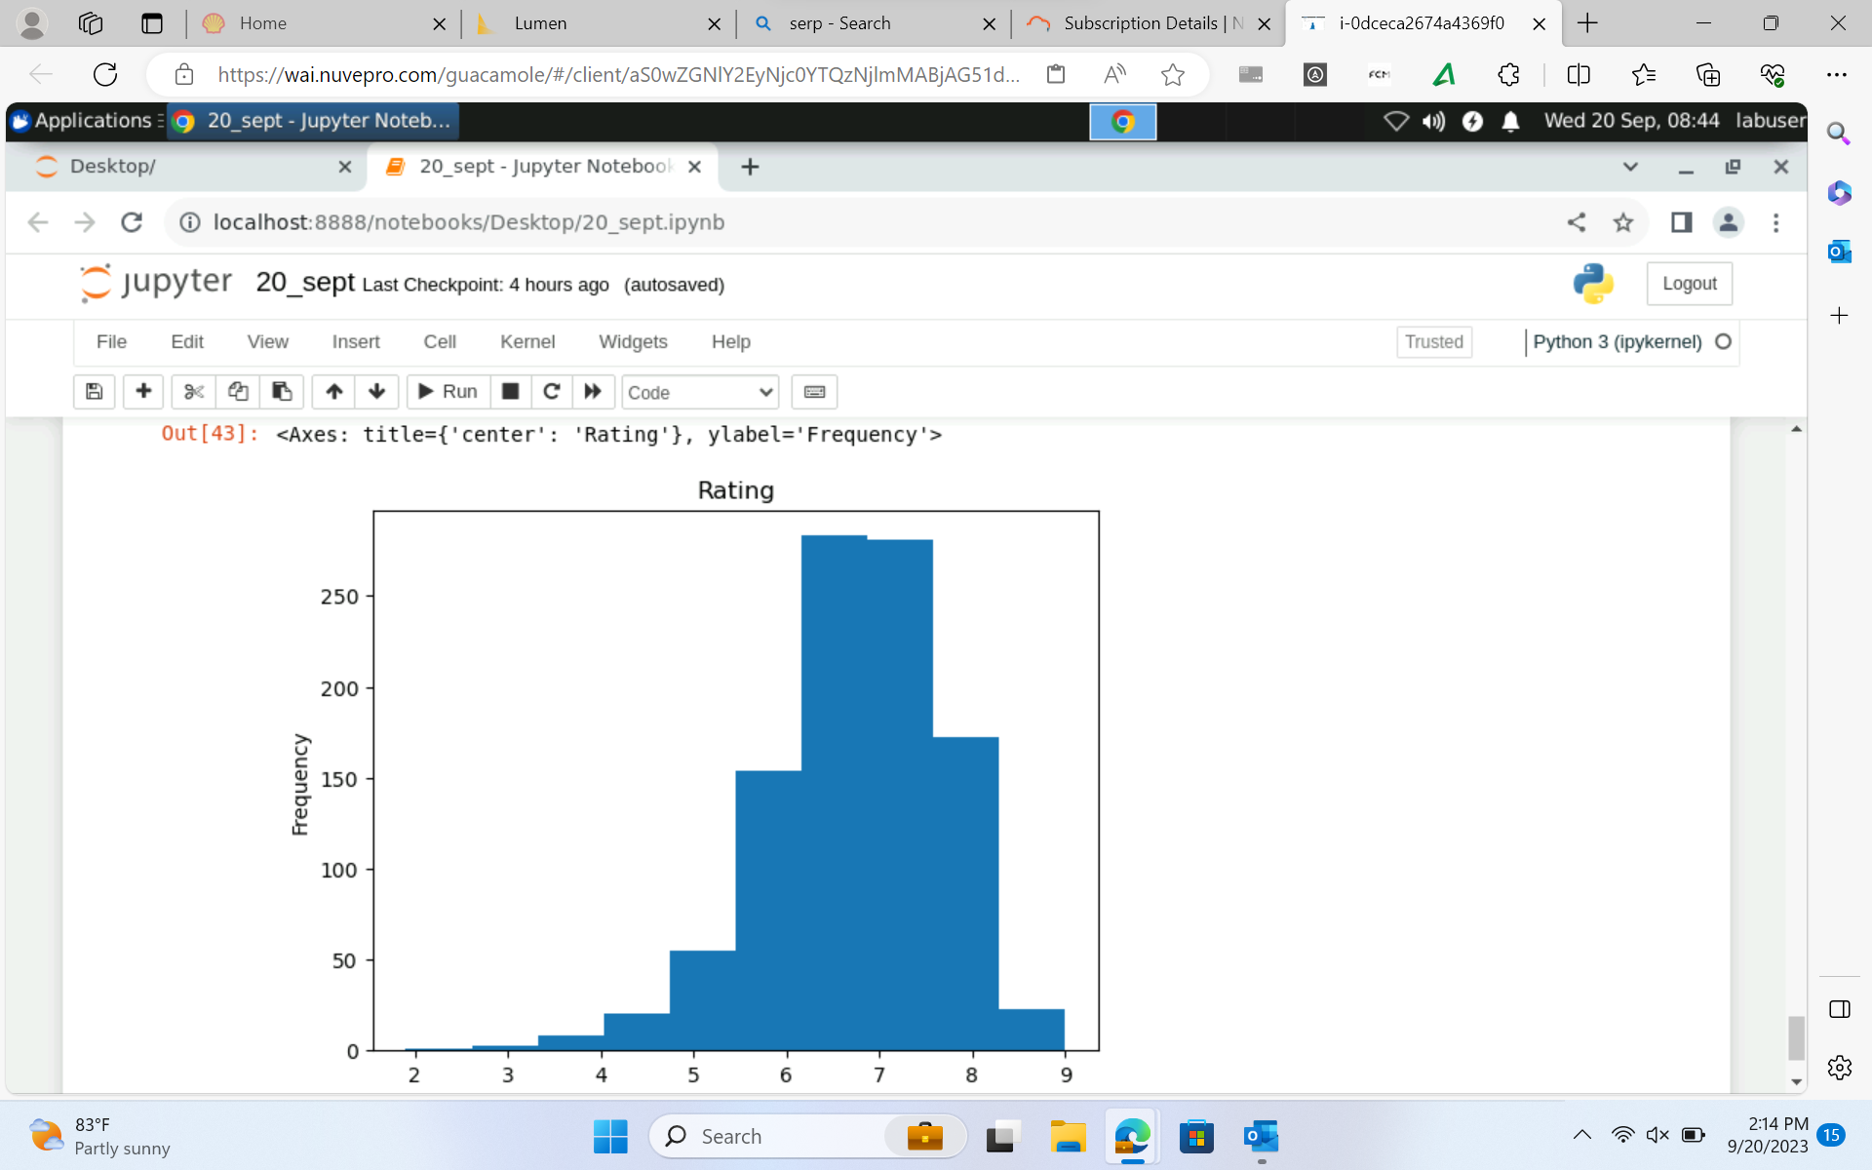
Python

Slide 10
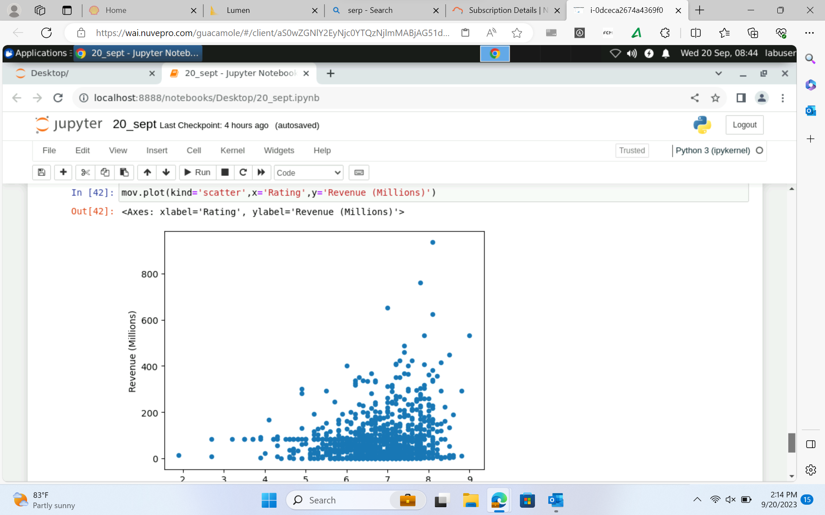
Python

Slide 11
Day 3 - PySpark
Understanding the components of PySpark, architecture of PySpark
Understanding the Job life-cycle in PySpark
Exploring Apache PySpark – use cases
Understanding PySpark Deployment modes
Writing PySpark Job – word count problem
Understanding Data framework, RDD
Understanding Transformation and Actions
Performing common Transformation and Actions like select, show, count, collect etc..

Slide 12
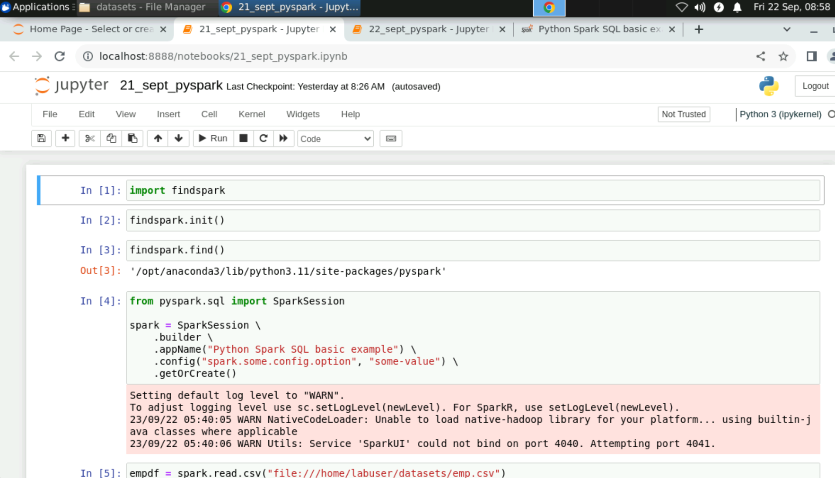
PySpark

Slide 13
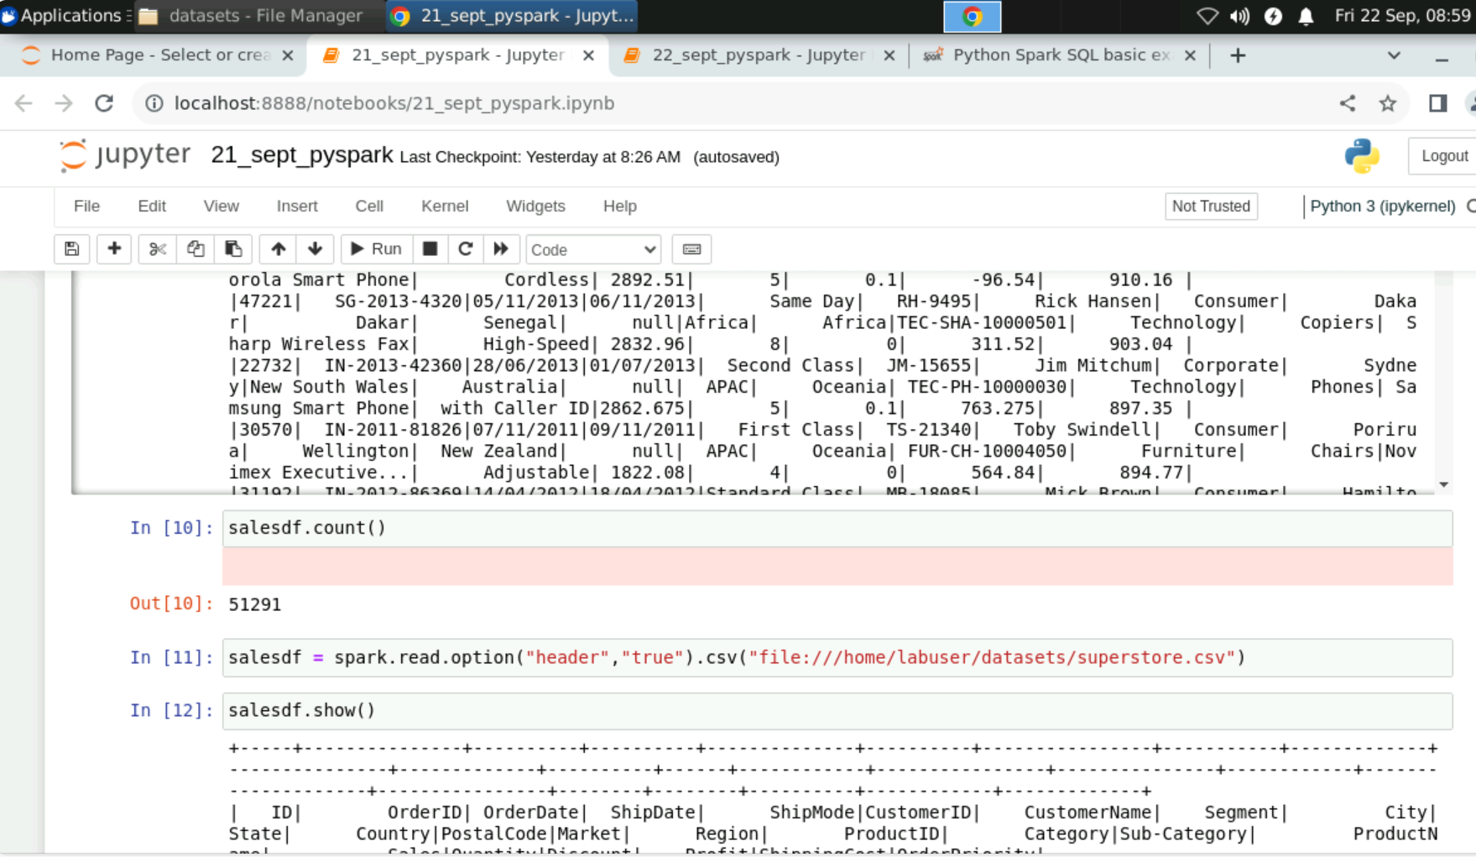
PySpark

Slide 14
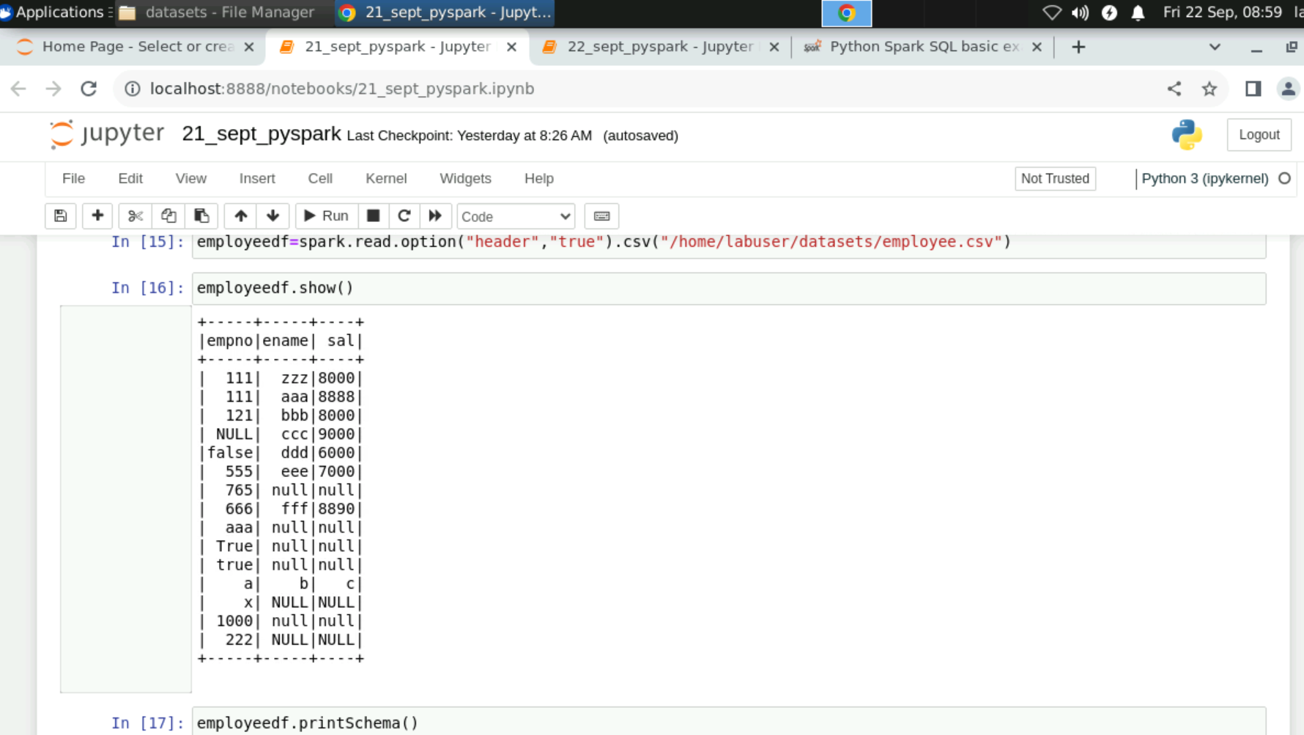
PySpark

Slide 15
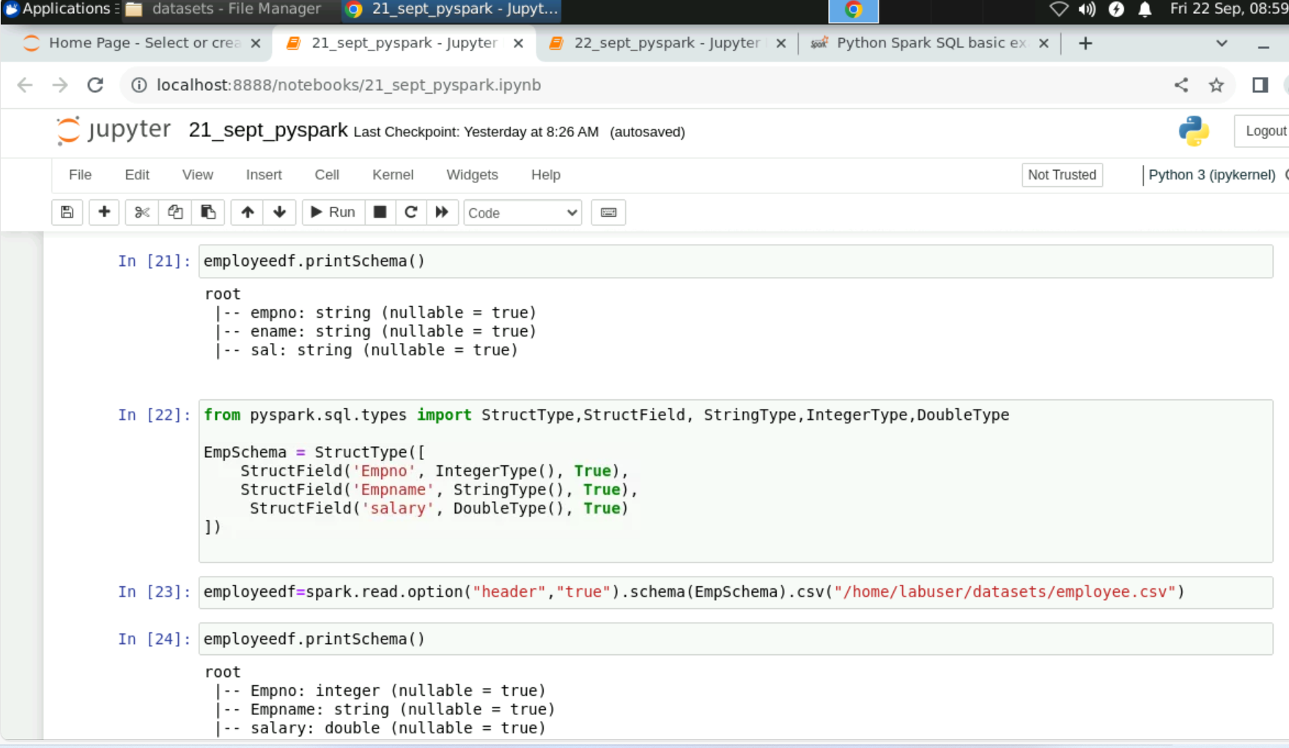
PySpark

Slide 16
Day 4 - PySpark cont..
Understanding Spark and Fault tolerance
Performing transformations using sample datasets - employee.csv and superstore.csv
Understanding Partitions – Departitioning, coalesce
Read – write operations in parquet, orc
Working on spark- sql : writing simple select queries
Understanding Caching in PySpark

Slide 17
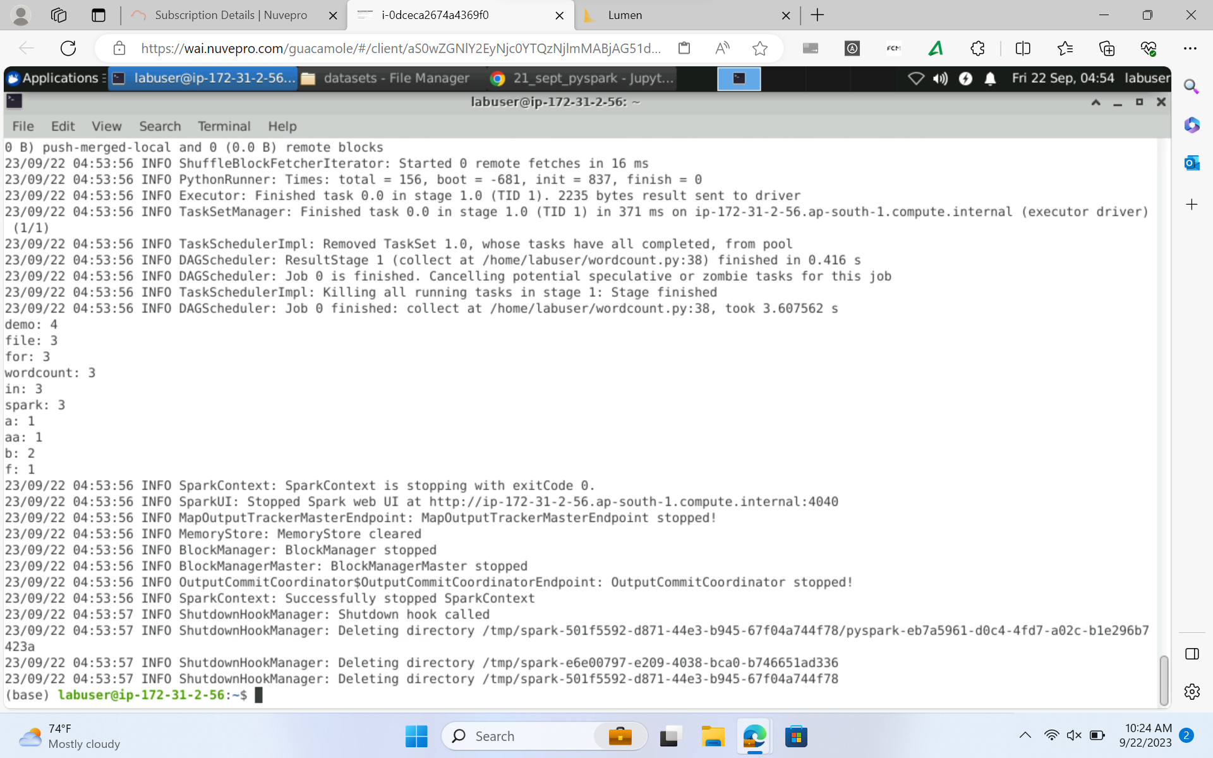
PySpark

Slide 18
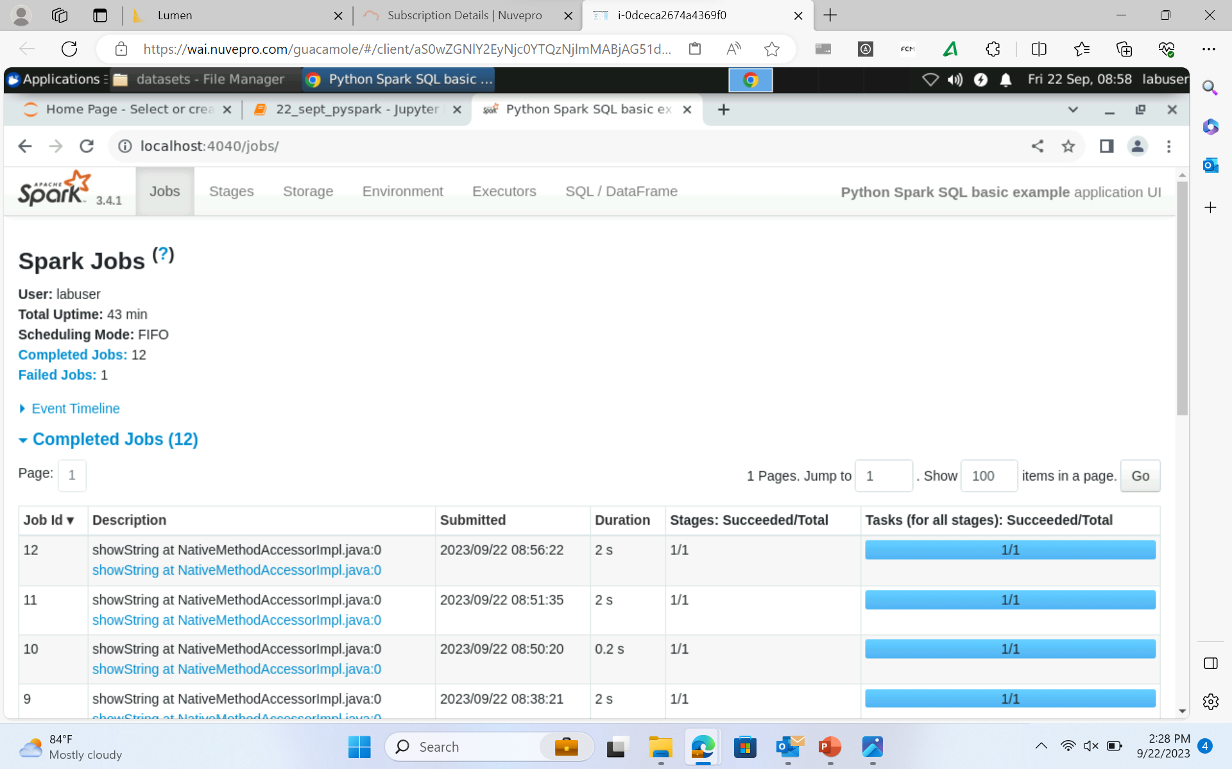
PySpark

Slide 19
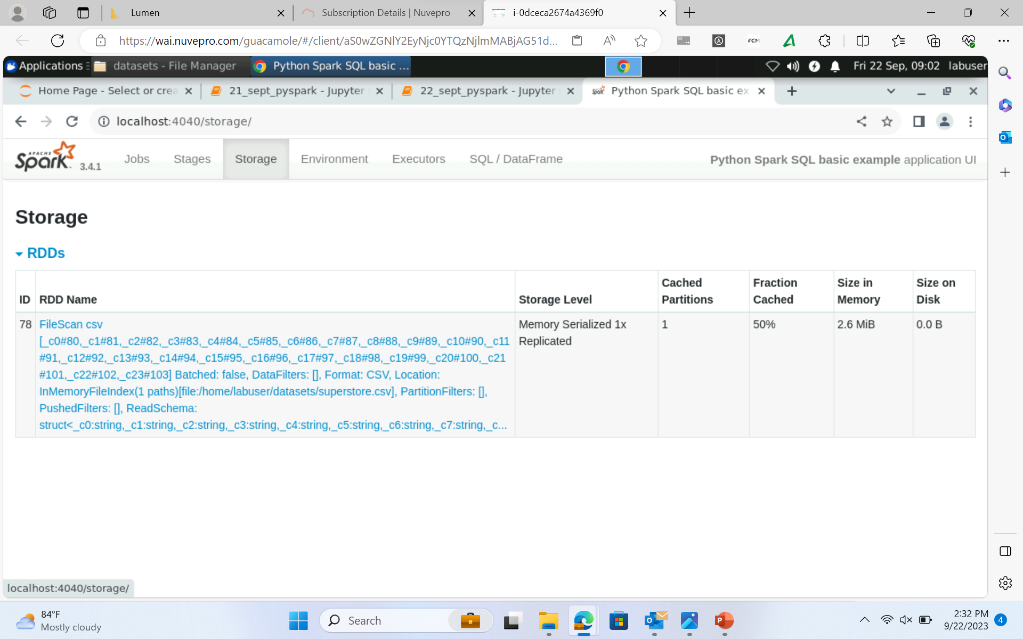
PySpark

